Slide 1
CPRE 513 Final Project: Conditional Generative Adversarial Network for Test Case Generation
Michael Holm, Long Ly, Grace Kuntz, Lucky Onyekwelu-Udoka, Md Shafiqul Islam

Slide 2
Problem Statement
It can be difficult to target a specific path when generating test cases for a large program
Fuzzing focuses on exploring unexplored paths but does not focus on completely exploring all possible inputs for a single path
A generative adversarial network (GAN) can be used to generate test cases that are similar to test cases used to train the network
Conditional GANs (CGANs) can be used to generate input similar to training data that has a specific label

Slide 3
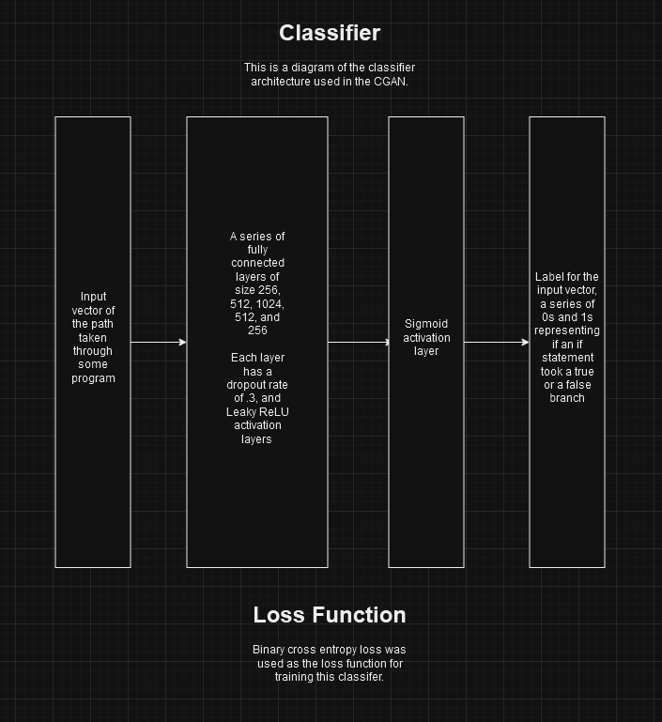
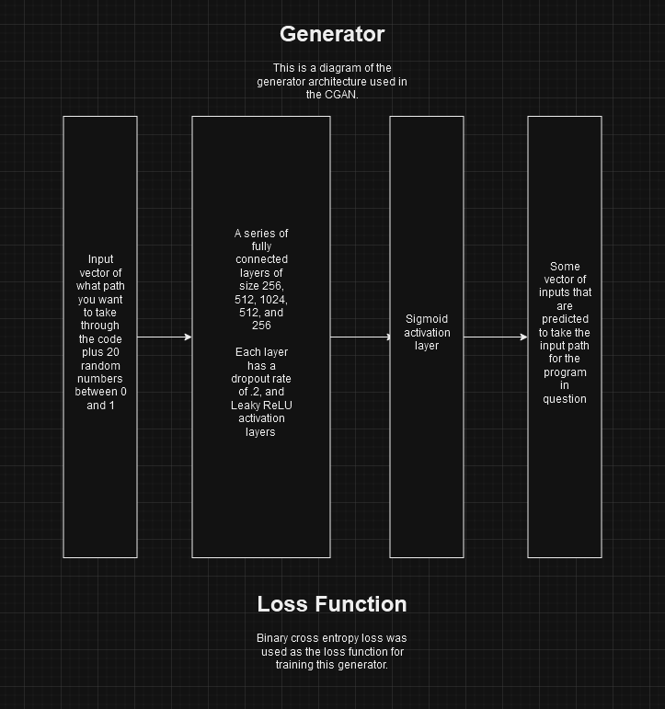
Architecture of the Network

